Slide 1
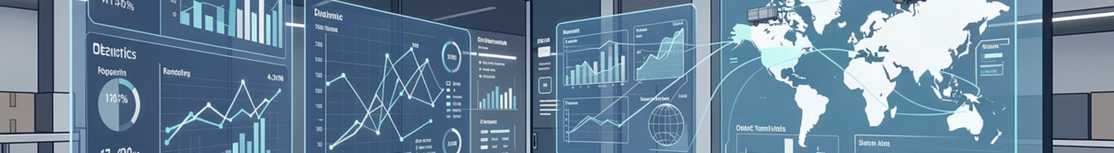






Supply Chain Analytics Project
A comprehensive data-driven approach to optimizing inventory management and supply chain performance through integrated analytics
Group Members
Jay Sherekar
Manav
Ashalata S
Arun Nag
Asma Anjum
Shivraj

Slide 2

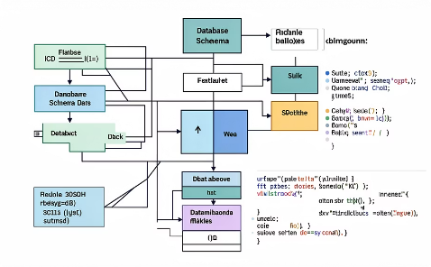

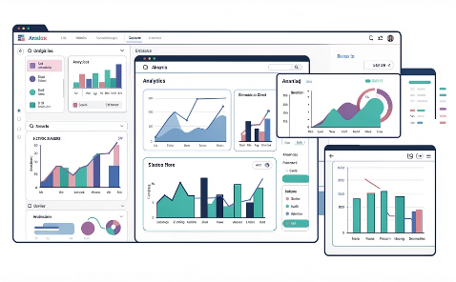

Project Team & Roles
Data Collection & Cleaning
SQL & Data Modeling
KPI Definition
Dashboard Development
Excel data validation and quality assurance
Schema design and data transformations
Business mapping and metric alignment
Excel, Tableau, and Power BI implementation
Insights & Recommendations
Strategic analysis and decision support
Tools leveraged: Excel | SQL | Tableau | Power BI

Slide 3
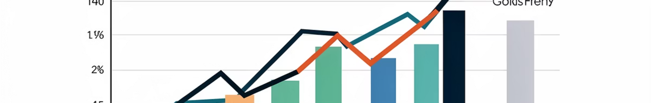
Project Objectives & Business Impact
Problem Context
Strategic Objectives
Excess inventory driving up holding costs
Demand-supply mismatch across regions
Limited visibility into supply chain performance
Reactive rather than proactive inventory management
Improve inventory control and accuracy
Enhance supply chain efficiency
Enable data-driven decision-making
Reduce operational costs
$
↑
📊
Reduced Capital
Better Fulfillment
Strategic Planning
Less money tied in excess inventory
Improved responsiveness to demand
Data-backed forecasting and allocation

Slide 4

Key Performance Indicators
Three critical categories measuring supply chain health and operational efficiency
1
2
3
Sales Performance
Inventory Performance
Supply Chain Efficiency
Total Sales Revenue
Average Order Value
Sales Growth Trends
Customer Acquisition
Inventory Value
Total Inventory Units
Inventory Turnover Ratio
Product-wise Contribution
Stock on Hand
Reorder Status
Cost per Unit
Delivery Lead Time
Business Relevance: These KPIs enable cost control, demand alignment, and operational efficiency tracking across the supply chain

Slide 5
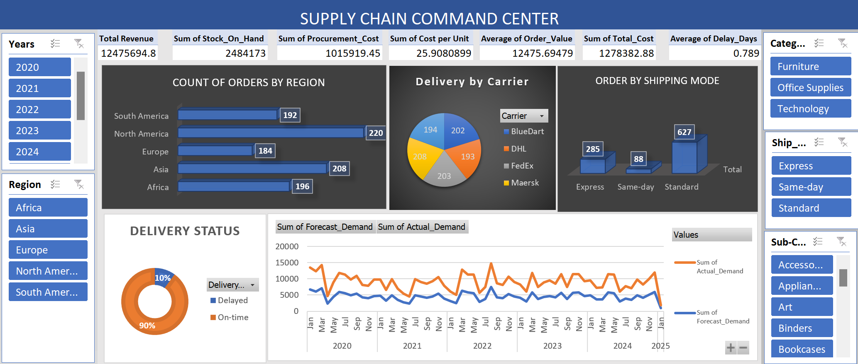
Excel Dashboard: Initial Analysis
This comprehensive Excel dashboard visually presents key inventory data, including stock levels, sales performance, and detailed product analysis, providing immediate insights for decision-making.

Slide 6
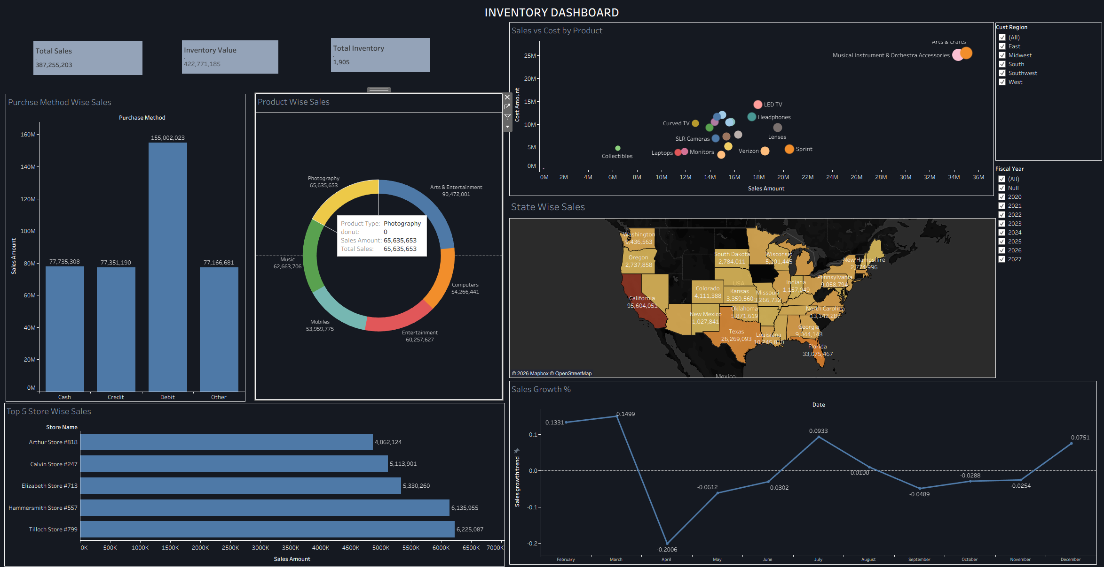



Tableau Dashboard: Interactive Exploration
Tableau enabled deep-dive analysis through interactive filtering and compelling visual storytelling
Product Performance Views
Interactive sales and inventory analysis by product category, SKU, and margin contribution with drill-down capabilities
Geographic Heatmaps
Visual mapping of demand versus inventory distribution across regions, highlighting
mismatch areas and opportunity zones
Store & Region Analytics
Performance comparison across locations with filtering by time period, product type, and business metrics
Sales Concentration
Low-Demand Inventory
Revenue heavily weighted in few high-performing regions
Stock present in areas with minimal customer demand
Redistribution Opportunity
Clear potential for inventory reallocation to high-demand zones

Slide 7
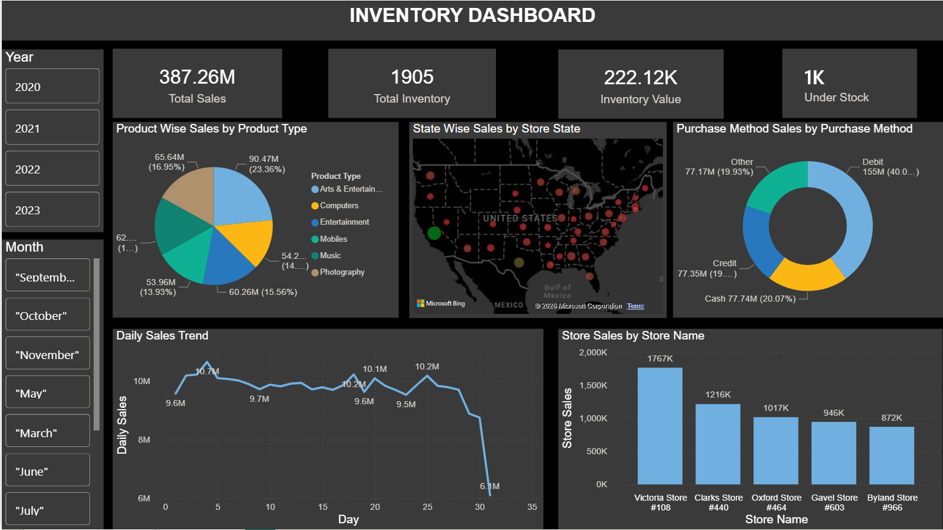
Power BI: Executive Monitoring
Why Power BI
Dashboard Highlights
Real-time KPI monitoring
Management-ready reporting
Automated data refresh
Mobile accessibility
Executive-level visibility into critical metrics
driving strategic decisions
Sales vs Inventory Value
Real-time comparison tracking the critical ratio between revenue and inventory investment
Reorder Alerts
Automated notifications when stock levels reach predefined thresholds
Supply Chain Tracking
Cost per unit and delivery lead time monitoring
across all routes and suppliers
Value Delivered: Real-time performance visibility with management-ready
insights enabling proactive decision-making

Slide 8
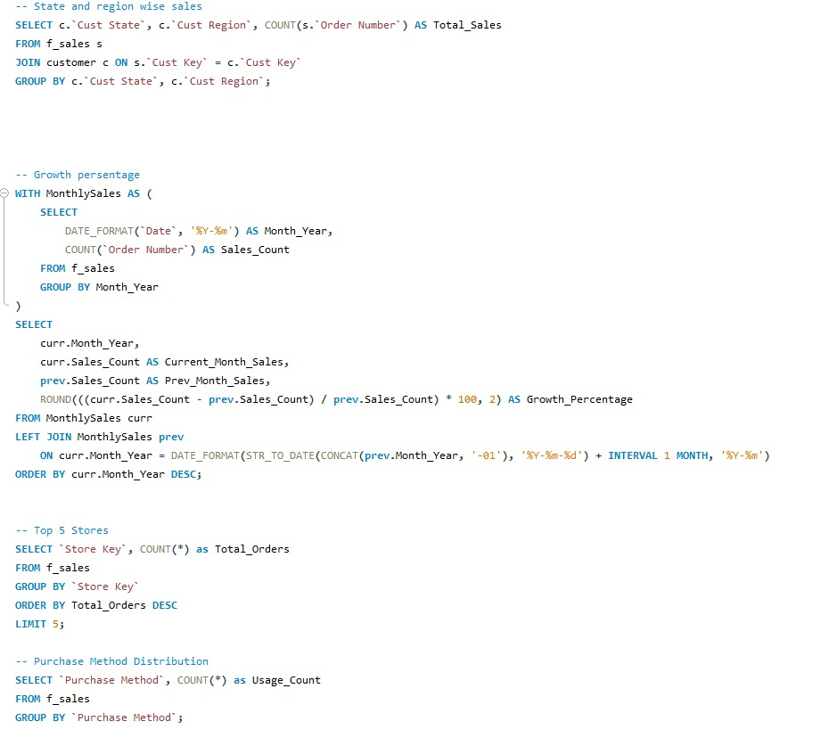
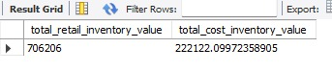
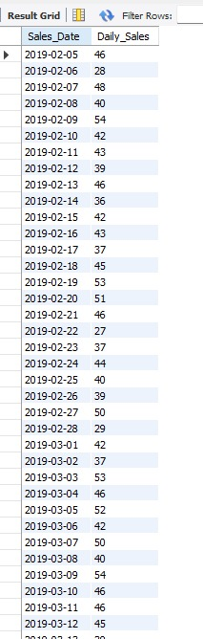
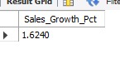
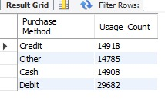
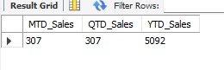
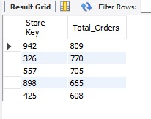
SQL & Data Modeling
We leveraged robust SQL queries for efficient data extraction and transformation, laying the foundation for our comprehensive supply chain analytics. These queries enabled us to pull, clean, and structure raw data from various sources into a format suitable for in-depth analysis.

Slide 9

Key Takeaways & Recommendations
Overstocking Risk Across Categories
Inventory levels significantly exceed demand patterns, creating working capital pressure and potential obsolescence risk
Slow-Moving Inventory Identified
Specific SKUs and product categories show poor turnover, requiring immediate attention and potential markdown strategies
Regional Demand Mismatch
Geographic analysis reveals inventory positioned in low-demand areas while high-demand regions face stockouts
Strategic Recommendations
01
02
Demand-Driven Inventory Planning
Inventory Turnover Metrics
Implement forecasting models aligned with actual sales patterns
Track aging inventory and establish clear reorder triggers
03
04
Optimized Logistics Routing
Automated Decision Support
Redistribute stock from low-demand to high-demand regions
Deploy real-time alerts and automated replenishment workflows
Future Scope: Integrate predictive forecasting models, implement real-time alerts for threshold breaches, and develop automated decision support systems for inventory replenishment

Slide 10

Thank You
Driving insights, achieving success together.

